Slide 1
2014 Leadership Meeting
GE MR PM Procedure

Slide 2
Basic GE MR PM Procedure
Objective
Build upon your current basic knowledge and perform a standard PM on a GE MRI system
Materials Needed
“GE MR PM Protocols” Word Document
GE Documentation for your system
Basic system and scanning knowledge
Vacuum
Flat blade screwdriver
Philips screwdriver
PM checklist

Slide 3
First Things First
Preliminary system checks and backups
Before you get started tearing into the system it’s a good idea to see where your at and get the software backed up.
Create a Save Info (next slide)
Check the error log for any glaring issues
Ask the Technologist(s) if they have had any reoccurring issues

Slide 4
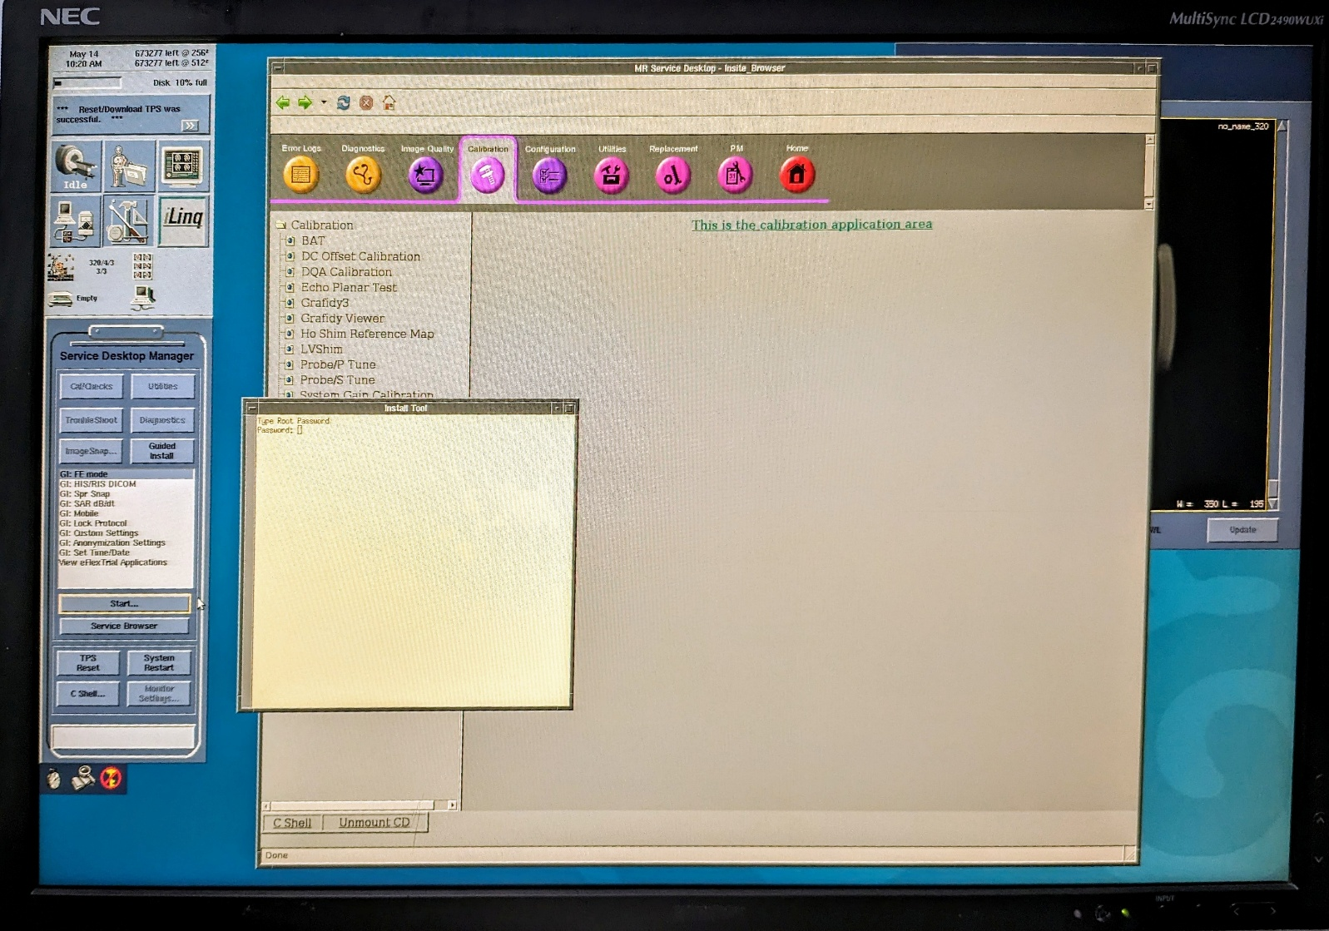
Save Info/GI
To do a Save Info:
Select the Tools page
Select “Guided Install”
Select “FE mode”
Click start
Type in the password
and hit enter

Slide 5
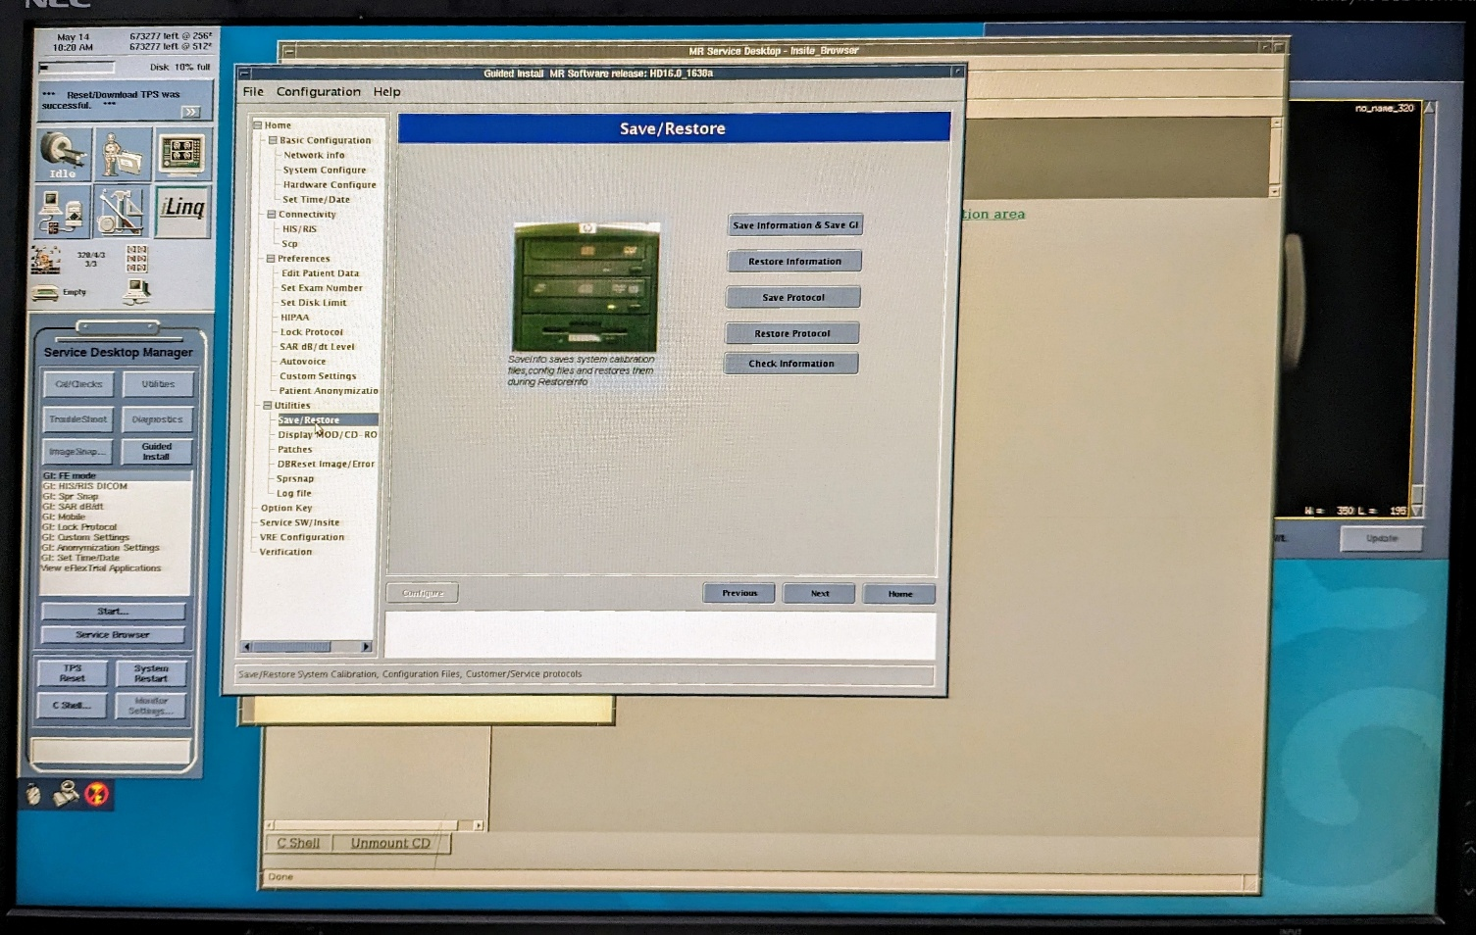
Save Info Page 3
Select the
“Save/Restore” tab
Select “Save
Information”
Wait a few minutes
for it to complete

Slide 6
System Scanning
What scans are we going to do?
DQA Z ISO & GRAD CALS
DC Offsets
LVshim
Head and Body SNR

Slide 7
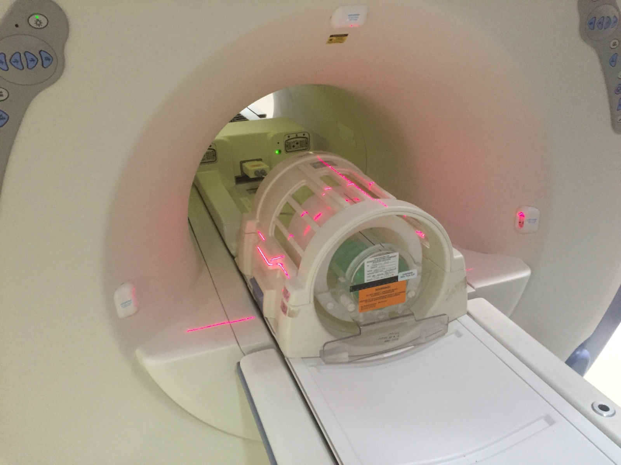
DQA Z ISO/GRAD CAL Procedure
Set up the Head Coil
and DQA III Phantom
like this and landmark
on the center, advance
to scan

Slide 8
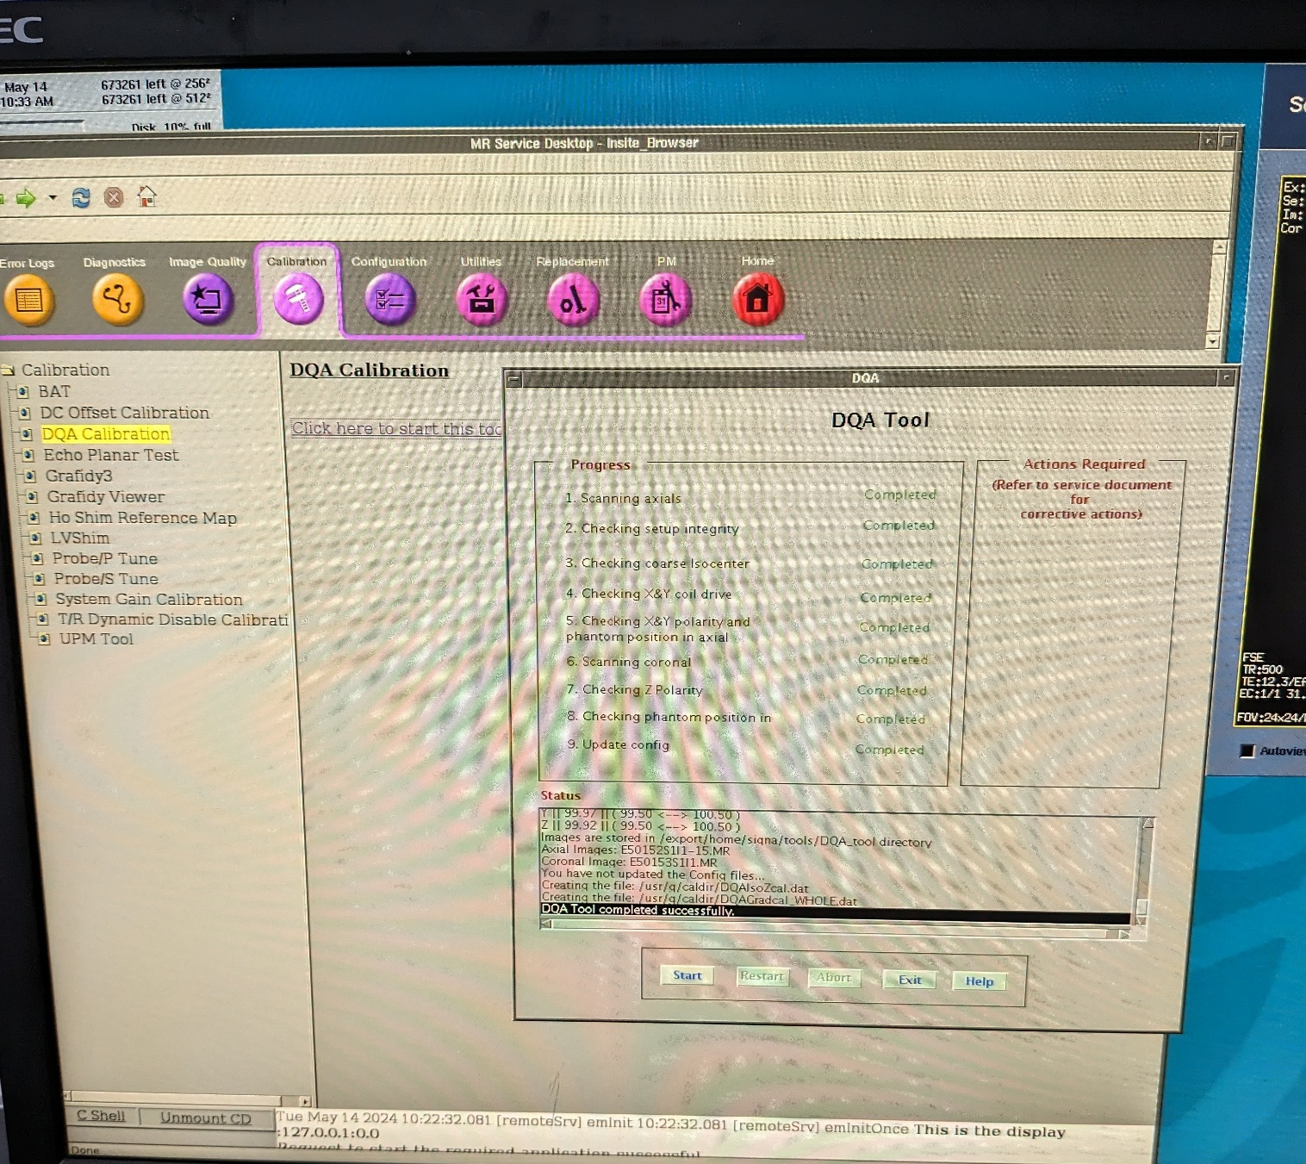
DQA TOOL
On the Tools Desktop,
select “Calibrations”
then “DQA Calibrations” to
start the tool

Slide 9
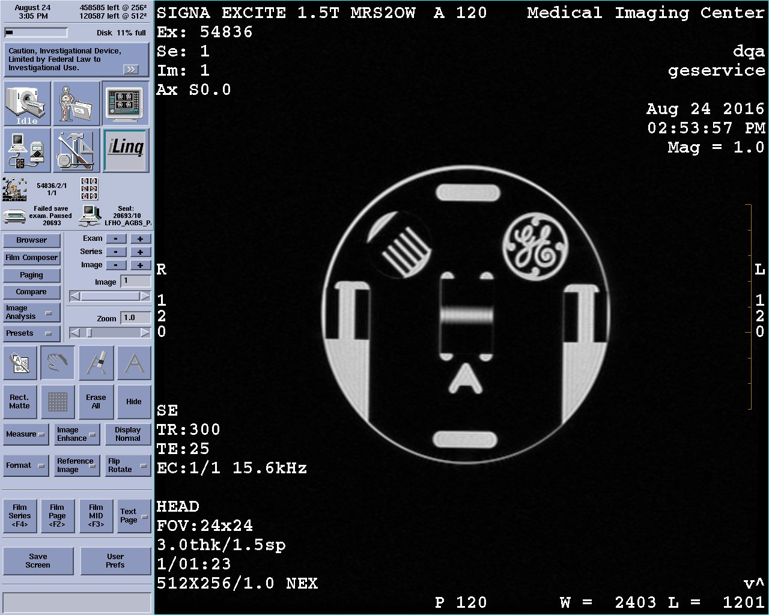
DQA Z ISO
Your ISO center image
should look like this.

Slide 10
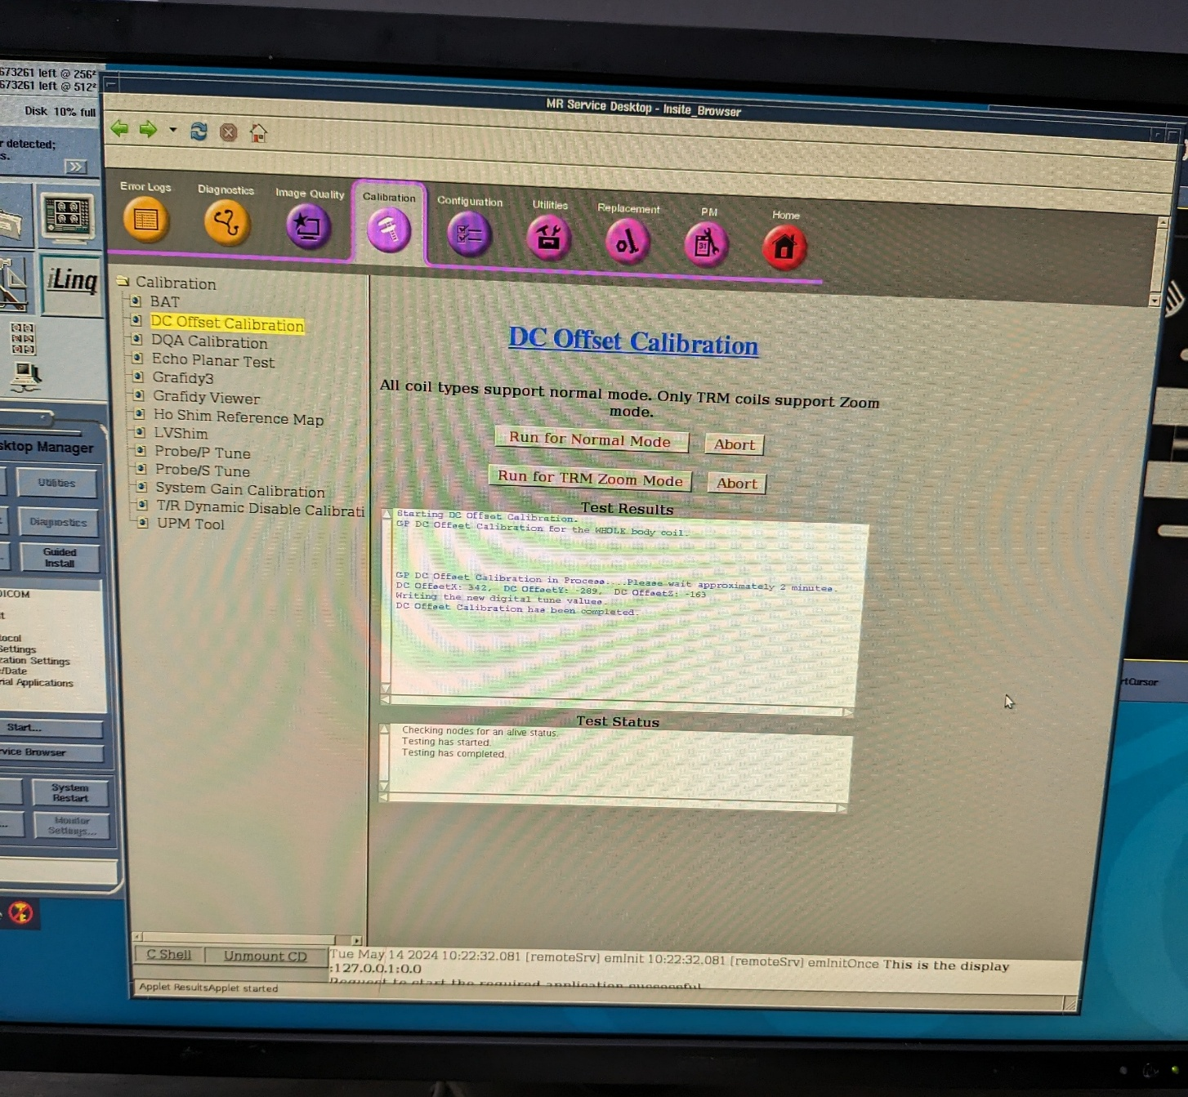
DC Offsets
You only need to run for
Normal Mode. Unless
You have a Twinspeed
System.
This scan doesn’t require
Any coil or phantom.
Its done when it says
“test complete” Takes
About 3 minutes.

Slide 11
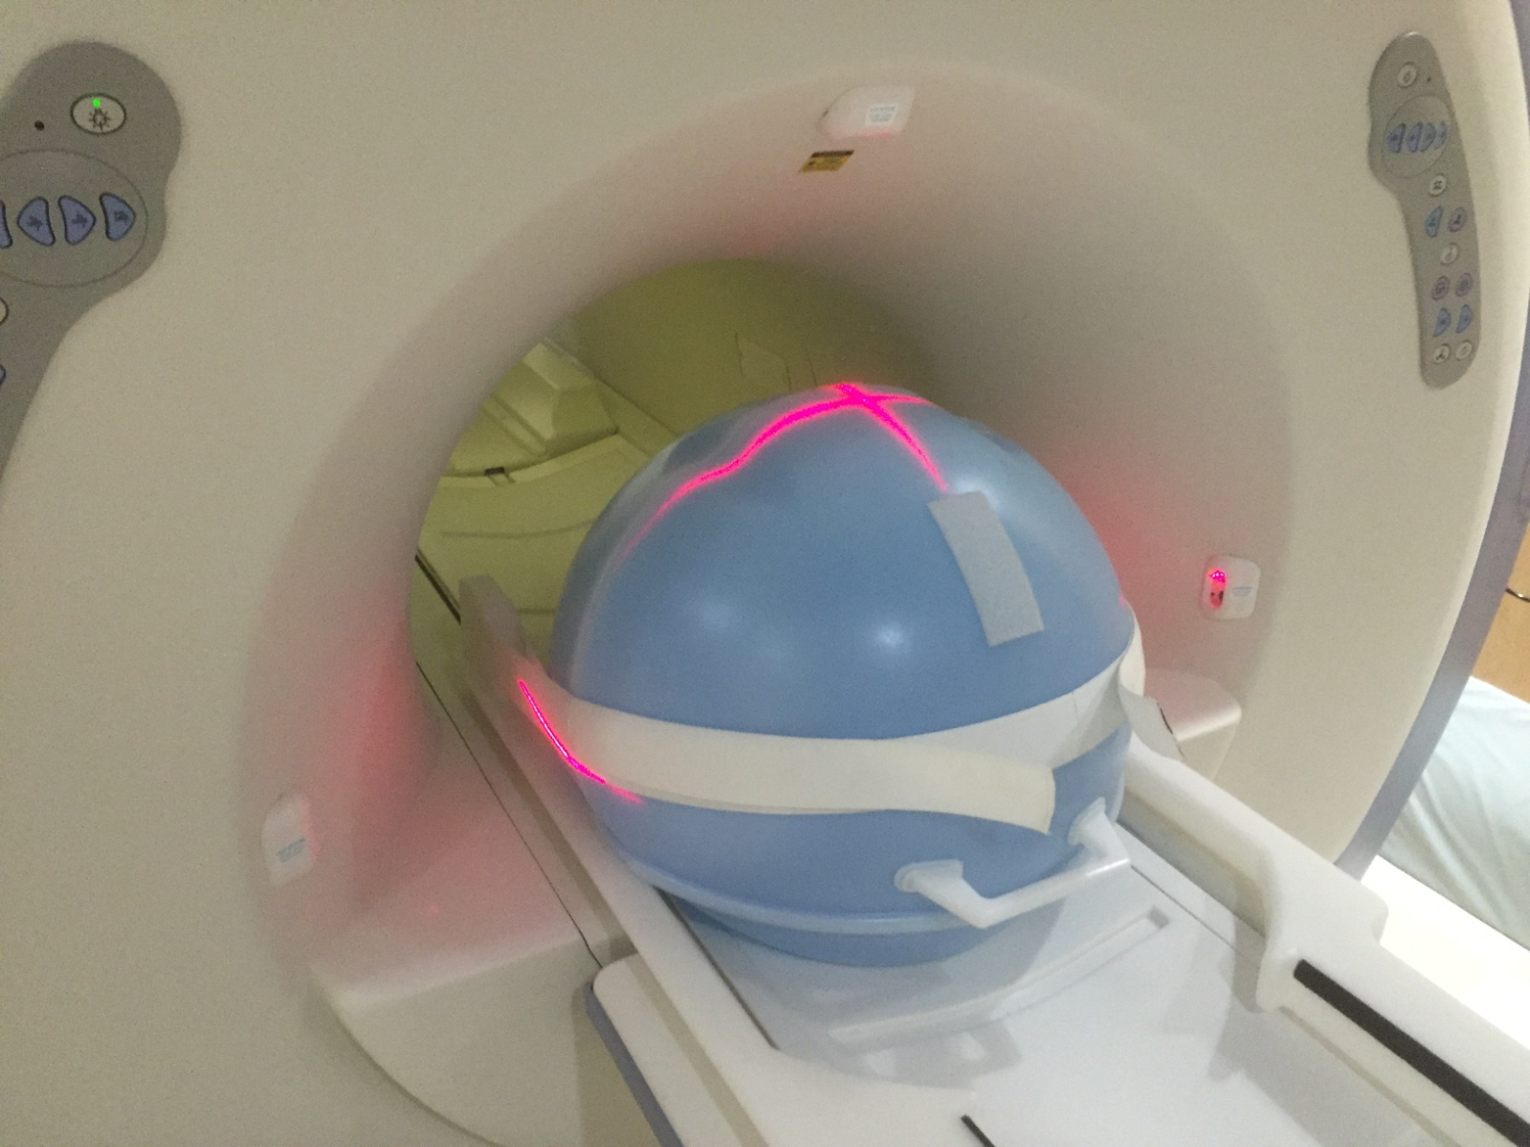
LV Shim Phantom Setup
Advance to scan
Save Series
Scan
Record the TG value

Slide 12
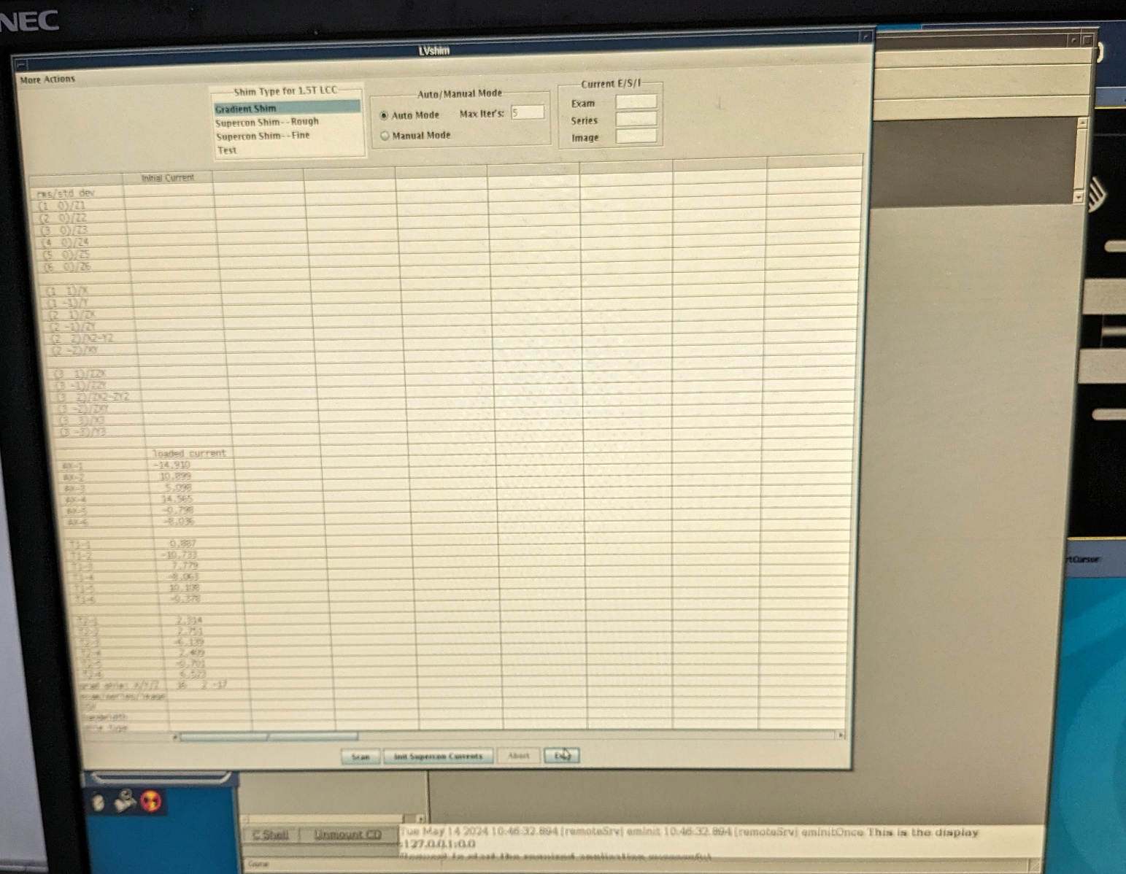
LV Shim Tool and Analysis
On the Tools Desktop,
select “Calibrations”
then “LV Shim” to
start the tool

Slide 13
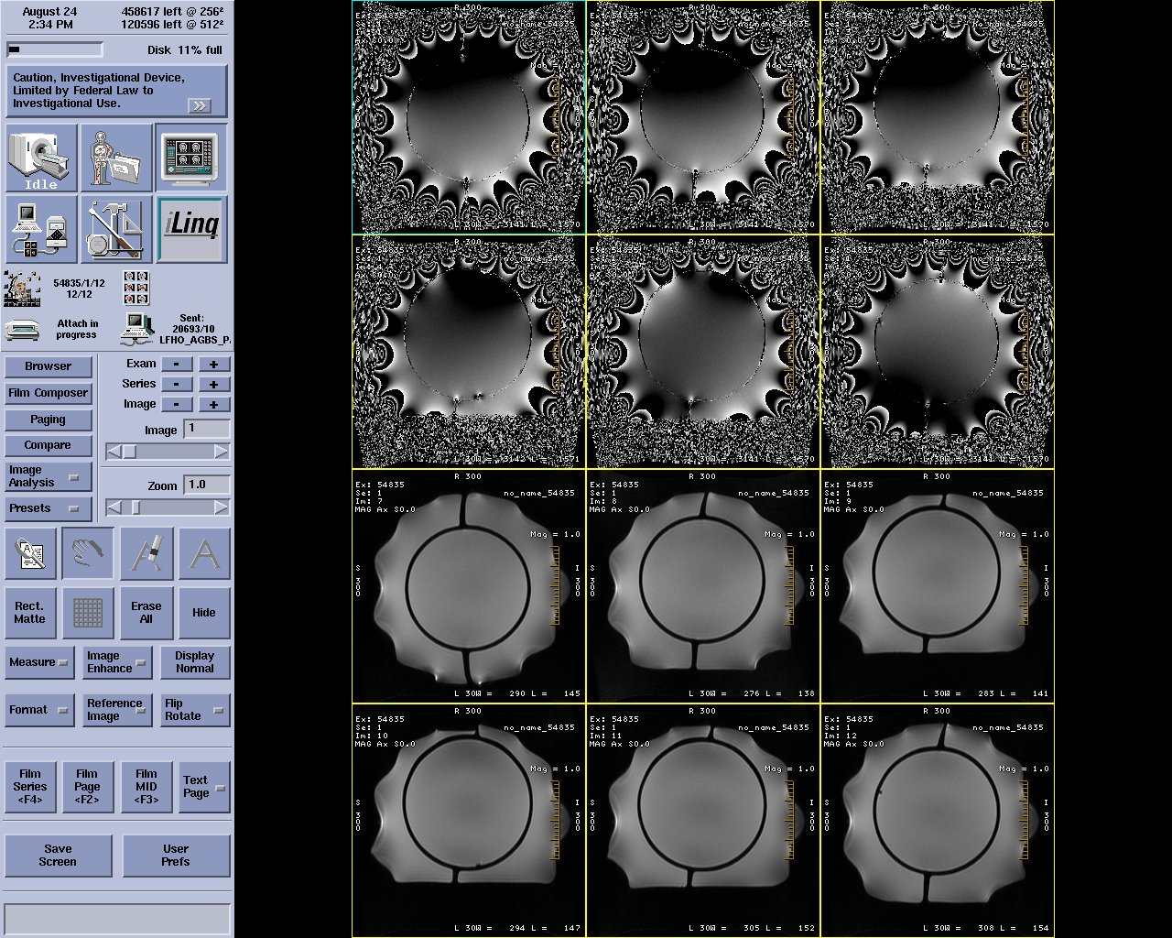
LV Shim Sample Images

Slide 14
Head and Body SNR
Head and Body SNR scans are very similar. They use very similar Protocols and Phantoms.
The SNR numbers obtained are subjective and are specific to your machine.
We can use numbers from other scanners to get a range that your machine should be within.
The SNR number are mainly used to detect a trending issue but can be use for troubleshooting.

Slide 15
Head and Body SNR Protocol
Head SNR
Series Description – Head SNR
Patient Position – Supine
Patient Entry - Head First
Coil - Head
Plane - Axial
Mode - 2D
Pulse Seq - Spin Echo
# of Echoes 1 (default)
TE [20]
TR [500]
FOV [24]
Slice Thickness [3]
Spacing [1.5]
Start 0
End 0
# of Slices 1 (default)
L/R Center 0 (default)
P/A Center 0 (default)
Freq [256]
Phase [256]
NEX [1]
Phase FOV 1.00 (default)
Freq Dir [A/P]
Auto Center Freq [Peak]
Body SNR
Series Description - Body SNR
Patient Position – Supine
Patient Entry - Head First
Coil - Body
Plane - Axial
Mode - 2D
Pulse Seq - Spin Echo
# of Echoes 1 (default)
TE [20]
TR [500]
FOV [48]
Slice Thickness [3]
Spacing [1.5]
Start 0
End 0
# of Slices 1 (default)
L/R Center 0 (default)
P/A Center 0 (default)
Freq [256]
Phase [256]
NEX [1]
Phase FOV 1.00 (default)
Freq Dir [A/P]
Auto Center Freq [Peak]

Slide 16
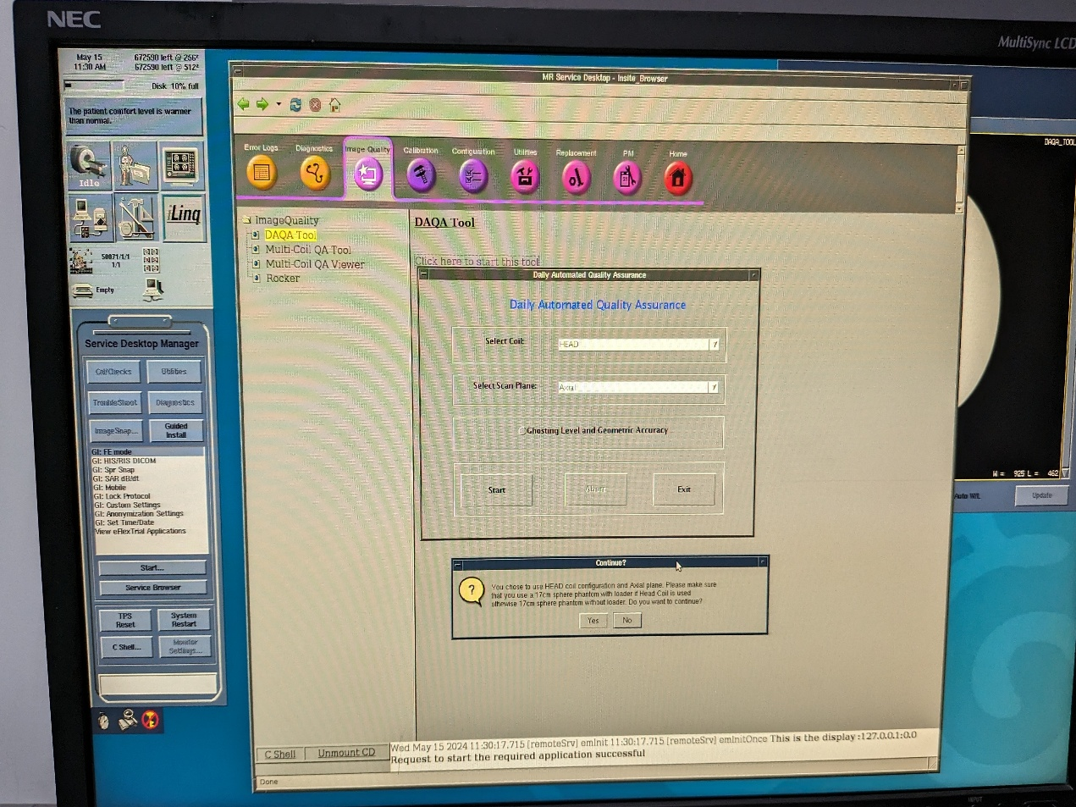
Head SNR Procedure
Put the Head TLT phantom
into the head coil at the
same spot that the DQA
phantom was.
Answer yes to the pop-ups. When
Scans are finished it will pop-up
SNR, Noise, TG, and Center Freq.
Numbers.

Slide 17

Body SNR
Body SNR is performed
the same way as the Head, but with the Body
Phantom. Scan and
analyze with the head
instructions.

Slide 18
Safety and Regulatory Checks
Not Applicable
Under System Level Procedures
Squeeze the Patient alert bulb
Under Patient Table
Under Patient Table
Under Patient Table
Under Patient Table
Under Patient Table
Under Patient Table
Under Patient Table
Under System Level Procedures
Under RF Cabinet, Select yours
See GE MRI Signa Excite Hdxt training PPT
Check O2 Monitor Operation (if applicable)
Check Peripheral Pulse Gating Cable
Check Patient Pneumatic Alert System
Check Emergency Release of Cradle
Check Emergency Release of Patient Transport
Check Patient Transport Casters
Check Patient Armboard Setscrews
Verify That Cradle Must Be At Home To Lower Table
Check Cradle Longitudinal Drive Clutch
Check All Cradle and Carriage Wheels
Check Emergency Off Circuits
Check Power Monitor Functional Test
Check Magnet Run Down Unit (ERU, MRU)

Slide 19
Other Checks
Under Blowers and Chillers
Under Patient Table
Under Patient Table
Under Magnet Enclosures
Check Gradient Coil Cooling Unit
Check Dock Pedal Springs
Check Patient Transport Hydraulic Fluid Level
Check Patient Alignment Lights

Slide 20
Delete Error Log and Remove Excess "core" Files
Delete the Error Log:
In a c-shell type storelog
Remove core files:
In a c-shell type cd /usr/g/service/log <enter>
Type rm –rf *core*

Slide 21
Magnet Checks
All values get recorded
Check the gauge on the magnet and the Magnet Monitor
On the front of the Shield Cooler
See below
On the Magnet Monitor
Gauge on the Shield Cooler
Record Magnet Pressure
Record Shield Cooler Hours
Calculate Lost Hours of Shield Cooler
Record Helium Level
Record Static Shield Cooler Compressor Pressure
Calculate Lost Hours
Take the hours you recorded on the last PM and subtract them from the hours on this PM. That will give you a total minutes lost. Divide by 60 to get the total hours. If there has been a helium loss since the last PM, this could account for it.

